Slide 1
Transfer Learning
Instructor: Dr. Yan Yan

Slide 2
Overview
Source Data (not directly related to the task)
labelled
unlabeled
Fine-tuning
Self-taught learning
labelled
Multitask Learning
Rajat Raina , Alexis Battle , Honglak Lee , Benjamin Packer , Andrew Y. Ng, Self-taught learning: transfer learning from unlabeled data, ICML, 2007
Target Data
Domain-adversarial training
Self-taught Clustering
unlabeled
Zero-shot learning
Wenyuan Dai, Qiang Yang, Gui-Rong Xue, Yong Yu, "Self-taught clustering", ICML 2008

Slide 3
Transfer Learning Introduction and Fine-tuning
Dr. Yan Yan

Slide 4
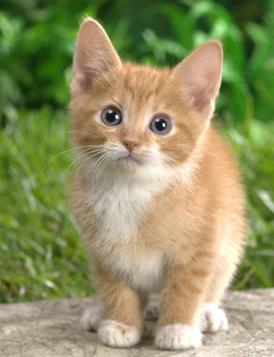
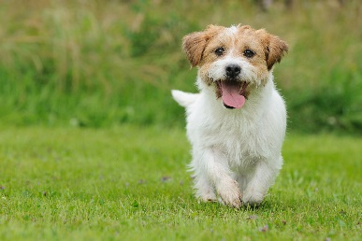

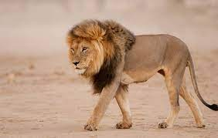
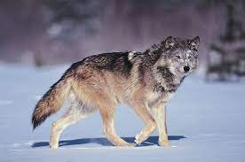
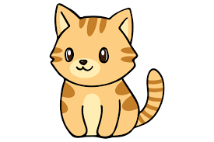
Transfer Learning
http://weebly110810.weebly.com/396403913129399.html
http://www.sucaitianxia.com/png/cartoon/200811/4261.html
Dog/Cat
Classifier
cat
dog
Data not directly related to the task considered
Lion
Wolf
cat
dog
Similar domain, different tasks
Different domains, same task

Slide 5


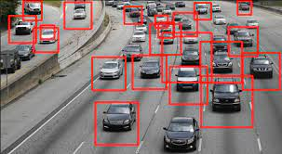
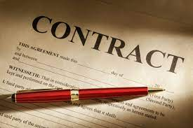

Why?
Task Considered
Data not directly related
Speech
Recognition
English
English
Chinese
……
Image Recognition
car
Text
Analysis
Specific domain
Webpages

Slide 6
Transfer Learning - Overview
Source Data (not directly related to the task)
labelled
unlabeled
Model Fine-tuning
labelled
Warning: different terminology in different literature
Target Data
unlabeled

Slide 7
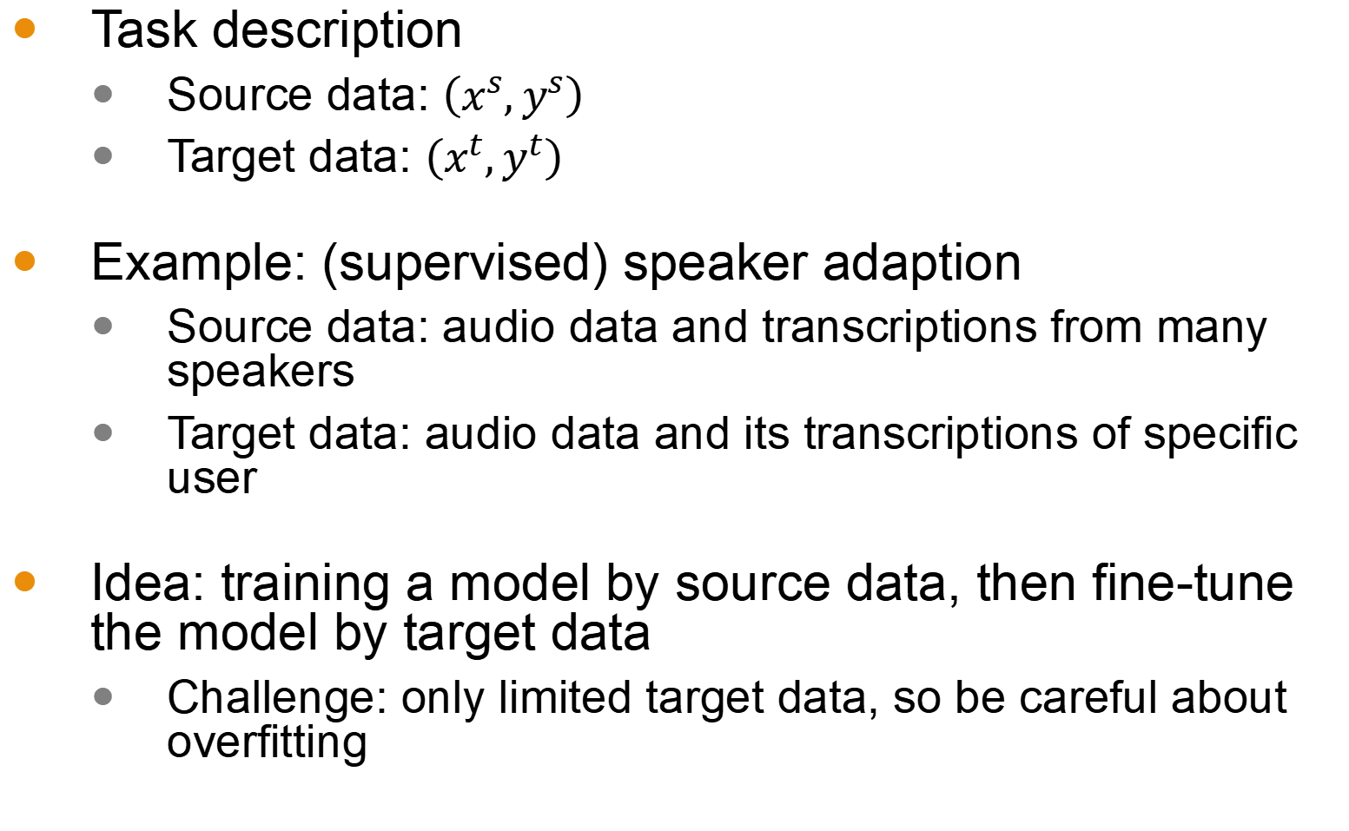
Model Fine-tuning
Model Fine-tuning
One-shot learning: only a few examples in target domain
Task description
Source data: $\left(x^{s},y^{s}\right)$
Target data: $\left(x^{t},y^{t}\right)$
Example: (supervised) speaker adaption
Source data: audio data and transcriptions from many speakers
Target data: audio data and its transcriptions of specific user
Idea: training a model by source data, then fine-tune the model by target data
Challenge: only limited target data, so be careful about overfitting
A large amount
Very little

Slide 8
Conservative Training
Output layer
output close
Output layer
parameter close
initialization
Input layer
Input layer
Source data
(e.g. Audio data of
Many speakers)
Target data (e.g. A little data from target speaker)

Slide 9
Layer Transfer
Output layer
Copy some parameters
Target data
Source data
Input layer
1. Only train the rest layers (prevent overfitting)
2. fine-tune the whole network (if there is sufficient data)

Slide 10






Layer Transfer
Which layer can be transferred (copied)?
Speech: usually copy the last few layers
Image: usually copy the first few layers
Pixels
Layer 1
Layer 2
Layer L
……
……
……
Lion
……
……
……
……
……
……

Slide 11
Layer Transfer - Image
fine-tune the whole network
Source: 500 classes from ImageNet
Only train the rest layers
Target: another 500 classes from ImageNet
Jason Yosinski, Jeff Clune, Yoshua Bengio, Hod Lipson, “How transferable are features in deep neural networks?”, NIPS, 2014

Slide 12
Layer Transfer - Image
Only train the rest layers
Jason Yosinski, Jeff Clune, Yoshua Bengio, Hod Lipson, “How transferable are features in deep neural networks?”, NIPS, 2014

Slide 13
Multitask Learning
Dr. Yan Yan

Slide 14
Transfer Learning - Overview
Source Data (not directly related to the task)
labelled
unlabeled
Fine-tuning
labelled
Multitask Learning
Target Data
unlabeled

Slide 15
Multitask Learning
The multi-layer structure makes NN suitable for multitask learning
Task A
Task B
Task A
Task B
Input feature
Input feature for task A
Input feature for task B

Slide 16
Multitask Learning - Multilingual Speech Recognition
states of French
states of German
states of Spanish
states of Italian
states of Mandarin
Human languages share some common characteristics.
acoustic features
Similar idea in translation: Daxiang Dong, Hua Wu, Wei He, Dianhai Yu and Haifeng Wang, "Multi-task learning for multiple language translation.“, ACL 2015

Slide 17
Multitask Learning - Multilingual
Mandarin only
Character Error Rate
With European Language
Hours of training data for Mandarin
Huang, Jui-Ting, et al. "Cross-language knowledge transfer using multilingual deep neural network with shared hidden layers." ICASSP, 2013
Huang, Jui-Ting, et al. "Cross-language knowledge transfer using multilingual deep neural network with shared hidden layers." ICASSP, 2013

Slide 18
Progressive Neural Networks
Task 1
Task 2
Task 3
input
input
input
Andrei A. Rusu, Neil C. Rabinowitz, Guillaume Desjardins, Hubert Soyer, James Kirkpatrick, Koray Kavukcuoglu, Razvan Pascanu, Raia Hadsell, “Progressive Neural Networks”, arXiv preprint 2016
Andrei A. Rusu, Neil C. Rabinowitz, Guillaume Desjardins, Hubert Soyer, James Kirkpatrick, Koray Kavukcuoglu, Razvan Pascanu, Raia Hadsell, “Progressive Neural Networks”, arXiv preprint 2016

Slide 19
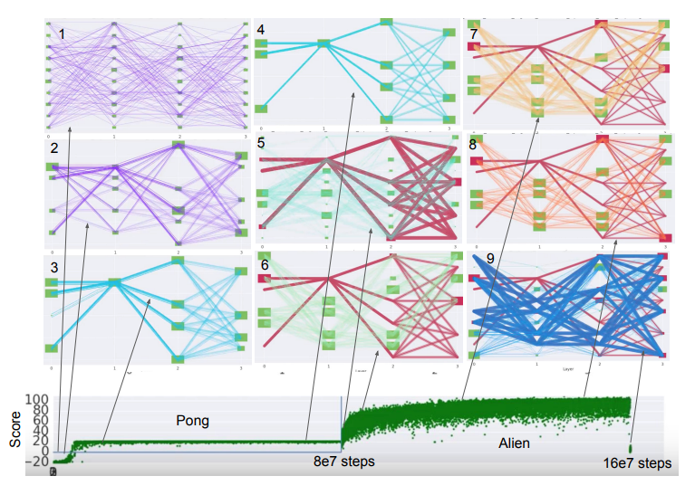
Chrisantha Fernando, Dylan Banarse, Charles Blundell, Yori Zwols, David Ha, Andrei A. Rusu, Alexander Pritzel, Daan Wierstra, “PathNet: Evolution Channels Gradient Descent in Super Neural Networks”, arXiv preprint, 2017
Chrisantha Fernando, Dylan Banarse, Charles Blundell, Yori Zwols, David Ha, Andrei A. Rusu, Alexander Pritzel, Daan Wierstra, “PathNet: Evolution Channels Gradient Descent in Super Neural Networks”, arXiv preprint, 2017

Slide 20
Domain-adversarial Training
Dr. Yan Yan

Slide 21
Transfer Learning - Overview
Source Data (not directly related to the task)
labelled
unlabeled
Fine-tuning
labelled
Multitask Learning
Target Data
Domain-adversarial training
unlabeled

Slide 22

Task description
Source data: $\left(x^{s},y^{s}\right)$
Target data: $\left(x^{t}\right)$
Training data
Same task, mismatch
Testing data
with label
without label

Slide 23
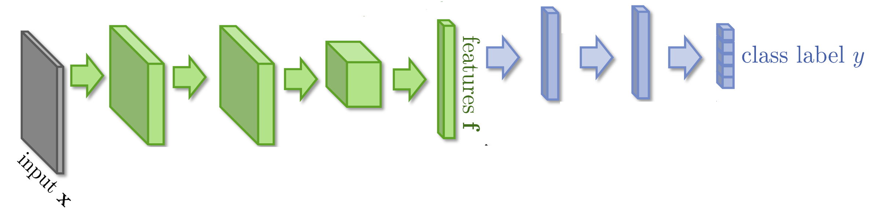


Domain-adversarial training

Slide 24
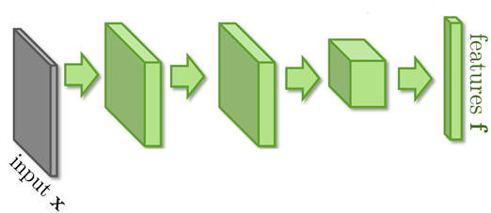
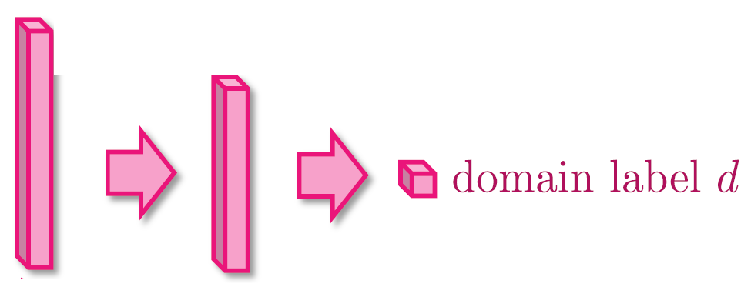


Domain-adversarial training
Similar to GAN
feature extractor
Too easy to feature extractor ……
Domain classifier

Slide 25
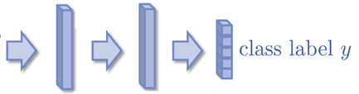
Domain-adversarial training
Maximize label classification accuracy + minimize domain classification accuracy
Maximize label classification accuracy
feature extractor
Label predictor
Domain classifier
Not only cheat the domain classifier, but satisfying label classifier at the same time
Maximize domain classification accuracy
This is a big network, but different parts have different goals.

Slide 26
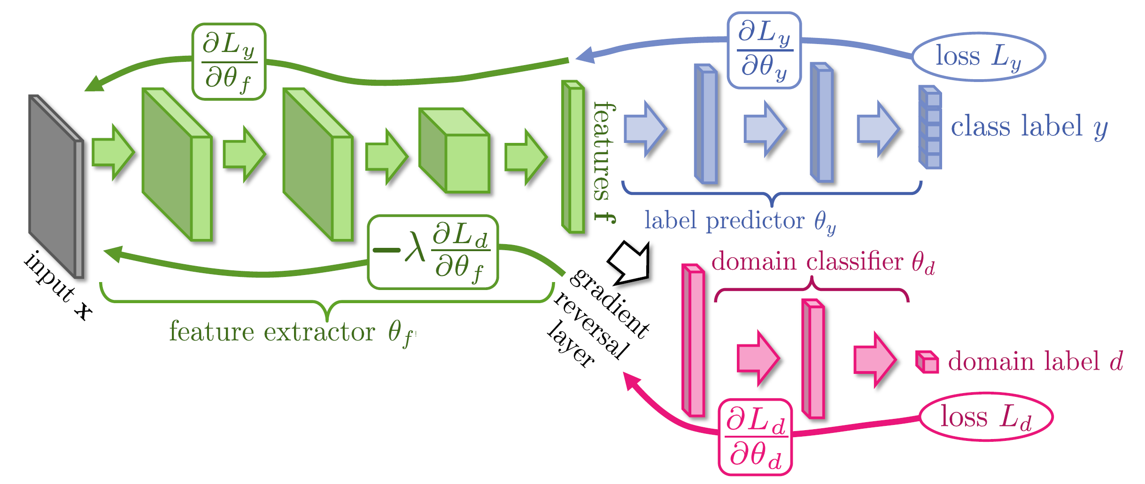
Domain-adversarial training
Domain classifier fails in the end
It should struggle ……
Yaroslav Ganin, Victor Lempitsky, Unsupervised Domain Adaptation by Backpropagation, ICML, 2015 Hana Ajakan, Pascal Germain, Hugo Larochelle, François Laviolette, Mario Marchand, Domain-Adversarial Training of Neural Networks, JMLR, 2016

Slide 27
Domain-adversarial training
Yaroslav Ganin, Victor Lempitsky, Unsupervised Domain Adaptation by Backpropagation, ICML, 2015
Hana Ajakan, Pascal Germain, Hugo Larochelle, François Laviolette, Mario Marchand, Domain-Adversarial Training of Neural Networks, JMLR, 2016

Slide 28
Zero-shot Learning
Dr. Yan Yan

Slide 29
Transfer Learning - Overview
Source Data (not directly related to the task)
labelled
unlabeled
Fine-tuning
labelled
Multitask Learning
Target Data
Domain-adversarial training
unlabeled
Zero-shot learning

Slide 30
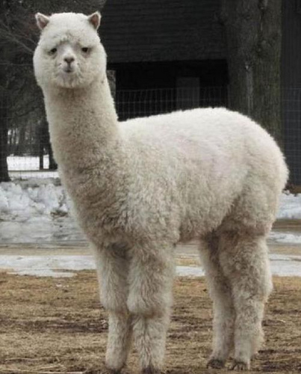
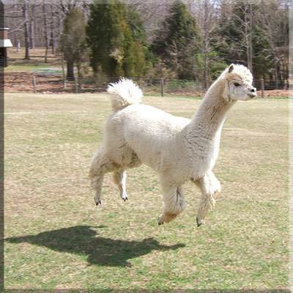



Zero-shot Learning
http://evchk.wikia.com/wiki/%E8%8D%89%E6%B3%A5%E9%A6%AC
Training data
Source data: $\left(x^{s},y^{s}\right)$
Target data: $\left(x^{t}\right)$
Different tasks
Testing data
$x^{s}$:
……
$x^{t}$:
$y^{s}$:
cat
dog
……

Slide 31
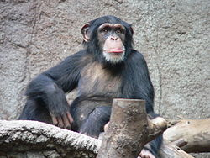
Zero-shot Learning
Representing each class by its attributes
Database
Training
attributes
1
0
0
1
1
1
 | furry | 4 legs | tail | …
Dog | O | O | O
Fish | X | X | O
Chimp | O | X | X
…
furry
4 legs
tail
furry
4 legs
tail
NN
NN
class
sufficient attributes for one to one mapping

Slide 32
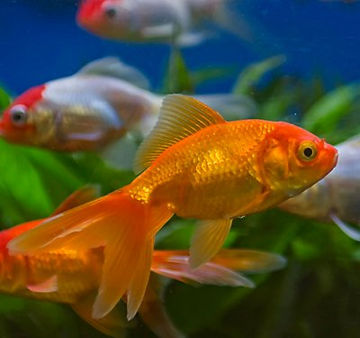
Zero-shot Learning
Representing each class by its attributes
Find the class with the most similar attributes
Testing
attributes
0
0
1
 | furry | 4 legs | tail | …
Dog | O | O | O
Fish | X | X | O
Chimp | O | X | X
…
furry
4 legs
tail
NN
class
sufficient attributes for one to one mapping

Slide 33
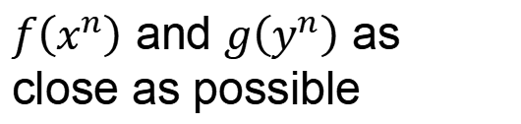







Zero-shot Learning
$f\left(∗\right)$ and $g\left(∗\right)$ can be NN.
Attribute embedding
Training target:
$f\left(x^{n}\right)$ and $g\left(y^{n}\right)$ as close as possible
x²
y¹ (attribute of chimp)
y² (attribute of dog)
x¹
$$f\left(x^{2}\right)$$
$$g\left(y^{2}\right)$$
$$f\left(x^{1}\right)$$
$$g\left(y^{1}\right)$$
y³ (attribute of Grass-mud horse)
$$g\left(y^{3}\right)$$
$$f\left(x^{3}\right)$$
x³
Embedding Space

Slide 34

Zero-shot Learning
Attribute embedding + word embedding
What if we don’t have database
y¹ (attribute of chimp)
x²
V(chimp)
y² (attribute of dog)
V(dog)
x¹
$$f\left(x^{2}\right)$$
$$g\left(y^{2}\right)$$
$$f\left(x^{1}\right)$$
$$g\left(y^{1}\right)$$
$$g\left(y^{3}\right)$$
$$f\left(x^{3}\right)$$
V(Grass-mud_horse)
x³
y³ (attribute of Grass-mud horse)
Embedding Space

Slide 35

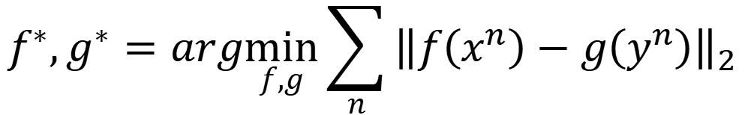
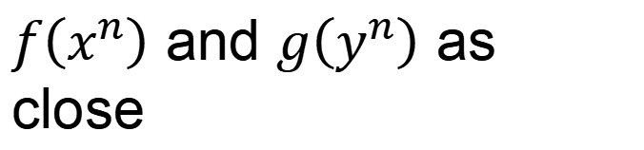
Zero-shot Learning
$$f^{∗},g^{∗}=arg\min_{f,g}{\sum_{n}{{\left\|f\left(x^{n}\right)−g\left(y^{n}\right)\right\|}_{2}}}$$
Problem?
$$f^{∗},g^{∗}=arg\min_{f,g}{\sum_{n}{max\left(0,k−f\left(x^{n}\right)∙g\left(y^{n}\right)+\max_{m≠n}{f\left(x^{m}\right)∙g\left(x^{m}\right)}\right)}}$$
Margin you defined
Zero loss:
$$k−f\left(x^{n}\right)∙g\left(y^{n}\right)+\max_{m≠n}{f\left(x^{n}\right)∙g\left(y^{m}\right)}<0$$
$$f\left(x^{n}\right)∙g\left(y^{n}\right)−\max_{m≠n}{f\left(x^{n}\right)∙g\left(y^{m}\right)}>k$$
$f\left(x^{n}\right)$ and $g\left(y^{n}\right)$ as close
$f\left(x^{n}\right)$ and $g\left(y^{m}\right)$ not as close

Slide 36
Zero-shot Learning
Convex Combination of Semantic Embedding
lion
tiger
V(tiger)
0.5
0.5
Find the closest word vector
V(liger)
NN
0.5V(tiger)+0.5V(lion)
V(lion)
Only need off-the-shelf NN for ImageNet and word vector

Slide 37
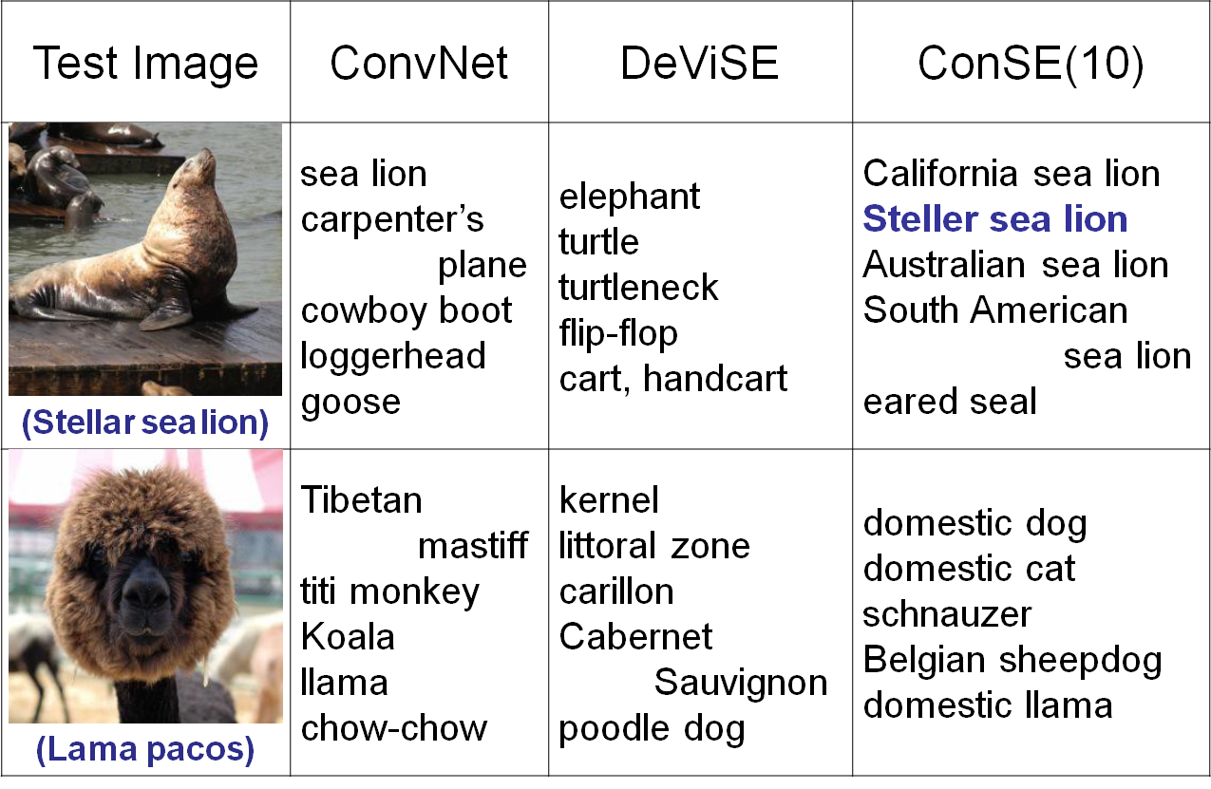
https://arxiv.org/pdf/1312.5650v3.pdf

Slide 38
Example of Zero-shot Learning
Melvin Johnson, Mike Schuster, Quoc V. Le, Maxim Krikun, Yonghui Wu, Zhifeng Chen, Nikhil Thorat. Google’s Multilingual Neural Machine Translation System: Enabling Zero-Shot Translation, arXiv preprint 2016

Slide 39
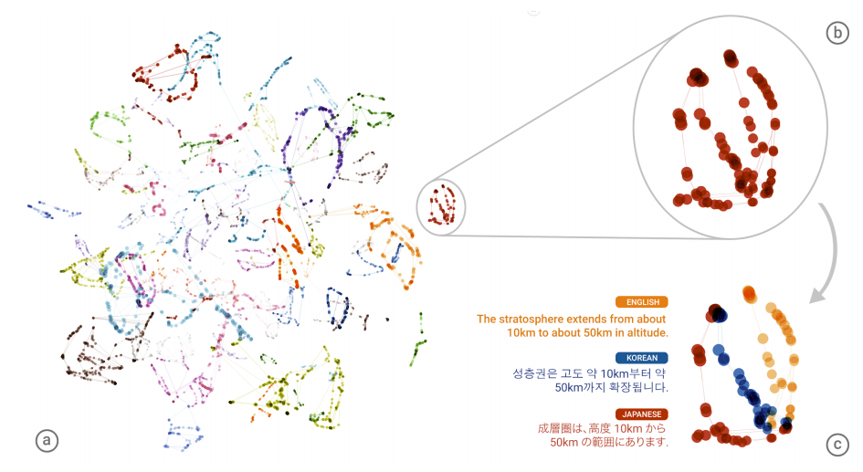
Example of Zero-shot Learning

Slide 40
Transfer Learning - Overview
Source Data (not directly related to the task)
labelled
unlabeled
Self-taught learning
Fine-tuning
labelled
Rajat Raina , Alexis Battle , Honglak Lee , Benjamin Packer , Andrew Y. Ng, Self-taught learning: transfer learning from unlabeled data, ICML, 2007
Multitask Learning
Different from semi-supervised learning
Target Data
Domain-adversarial training
unlabeled
Self-taught Clustering
Zero-shot learning
Wenyuan Dai, Qiang Yang, Gui-Rong Xue, Yong Yu, "Self-taught clustering", ICML 2008

Slide 41
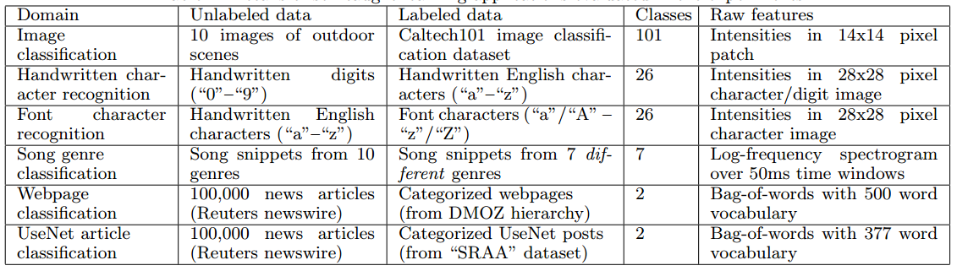
Self-taught learning
Learning to extract better representation from the source data (unsupervised approach)
Extracting better representation for target data

